Slide 1
Lecture 07: Memory Hierarchy
Notes:
CS2007

Slide 2
Outline
Memory hierarchy
Locality
Cache design
Virtual address spaces
Page table layout
Virtual memory summary
TLB design options
Conclusion

Slide 3
Since 1980, CPU has outpaced DRAM ...
Q. How do architects address this gap?
A. Put smaller, faster “cache” memories between CPU and DRAM.
Create a “memory hierarchy”.
Performance
(1/latency)
CPU
60% per yr
2X in 1.5 yrs
1000
CPU
100
Gap grew 50% per year
10
DRAM
9% per yr
2X in 10 yrs
DRAM
1980
1990
2000
Year

Slide 4
Levels of the Memory Hierarchy
Capacity
Access Time
Cost
Upper Level
Staging
Xfer Unit
faster
CPU Registers
100s Bytes
<10s ns
Registers
Instr. Operands
prog./compiler
1-8 bytes
Cache
K Bytes
10-100 ns
1-0.1 cents/bit
Cache
Blocks
cache cntl
8-128 bytes
Main Memory
M Bytes
200ns- 500ns
$.0001-.00001 cents /bit
Memory
Pages
OS
512-4K bytes
Disk
G Bytes, 10 ms
(10,000,000 ns)
10 -10 cents/bit
Disk
-5
-6
Files
user/operator
Mbytes
Tape
infinite
sec-min
10
Larger
Tape
Lower Level
-8
Notes:
CS2007

Slide 5


Memory Hierarchy: Apple iMac G5
Managed
by compiler
Managed
by hardware
Managed by OS,
hardware,
application
07 | Reg | L1 Inst | L1 Data | L2 | DRAM | Disk
Size | 1K | 64K | 32K | 512K | 256M | 80G
Latency Cycles, Time | 1, 0.6 ns | 3, 1.9 ns | 3, 1.9 ns | 11, 6.9 ns | 88, 55 ns | 10⁷, 12 ms
iMac G5
1.6 GHz
Goal: Illusion 假象 of large, fast, cheap memory
Let programs address a memory space that scales to the disk size, at a speed that is usually as fast as register access
Notes:
CS2007
一体化计算机

Slide 6
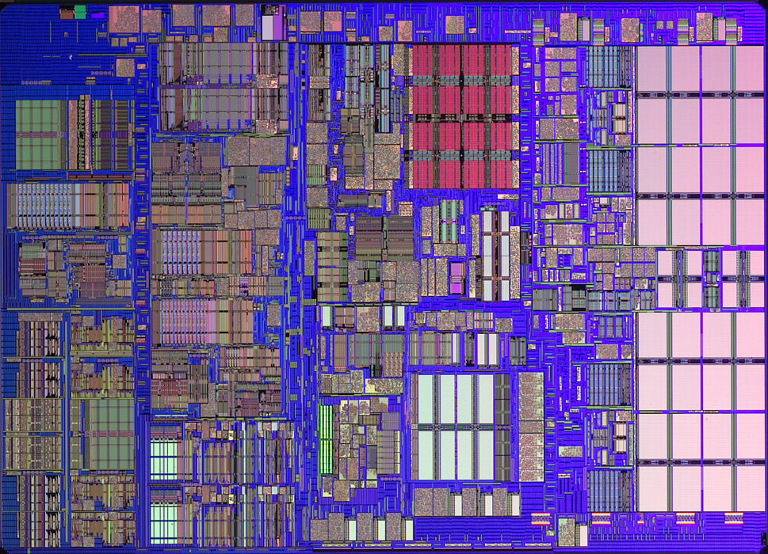
iMac’s PowerPC 970: All caches on-chip
L1 (64K Instruction)
Registers
512K
L2
(1K)
L1 (32K Data)

Slide 7
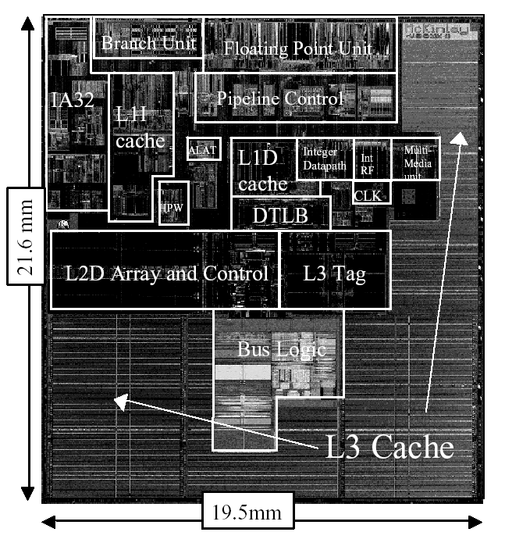
Itanium-2 On-Chip Caches
(Intel/HP, 2002)
Level 1, 16KB, 4-way s.a., 64B line, quad-port (2 load+2 store), single cycle latency
Level 2, 256KB, 4-way s.a, 128B line, quad-port (4 load or 4 store), five cycle latency
Level 3, 3MB, 12-way s.a., 128B line, single 32B port, twelve cycle latency
Notes:
CS2007
If two is good, then three must be better (jse)

Slide 8
The Principle of Locality
The Principle of Locality: 局部性原理
  Program access a relatively small portion of the address space at any instant of time.
Two Different Types of Locality:
  Temporal Locality (Locality in Time): If an item is referenced, it will tend to be referenced again soon (e.g., loops, reuse)
  Spatial Locality (Locality in Space): If an item is referenced, items whose addresses are close by tend to be referenced soon
  (e.g., straightline code, array access)
Last 15 years, HW relied on locality for speed
It is a property of programs which is exploited in machine design.
Notes:
CS2007
The principle of locality states that programs access a relatively small portion of the address space at any instant of time.
This is kind of like in real life, we all have a lot of friends. But at any given time most of us can only keep in touch with a small group of them.
There are two different types of locality: Temporal and Spatial. Temporal locality is the locality in time which says if an item is referenced, it will tend to be referenced again soon.
This is like saying if you just talk to one of your friends, it is likely that you will talk to him or her again soon.
This makes sense. For example, if you just have lunch with a friend, you may say, let’s go to the ball game this Sunday. So you will talk to him again soon.
Spatial locality is the locality in space. It says if an item is referenced, items whose addresses are close by tend to be referenced soon.
Once again, using our analogy. We can usually divide our friends into groups. Like friends from high school, friends from work, friends from home.
Let’s say you just talk to one of your friends from high school and she may say something like: “So did you hear so and so just won the lottery.”
You probably will say NO, I better give him a call and find out more.
So this is an example of spatial locality. You just talked to a friend from your high school days. As a result, you end up talking to another high school friend. Or at least in this case, you hope he still remember you are his friend.
+3 = 10 min. (X:50)

Slide 9
“Cache－主存”与“主存－辅存”层次的区别
存储层次
“Cache －主存”层次
“主存－辅存”层次
比较项目
目 的
为了弥补主存速度的不足
为了弥补主存容量的不足
存储管理实现
主要由专用硬件实现
主要由软件实现
访问速度的比值
(第一级和第二级)
几比一
几百比一
典型的块(页)大小
几十个字节
几百到几千个字节
CPU对第二级的
访问方式
可直接访问
均通过第一级
失效时CPU是否切换
不切换
切换到其他进程

Slide 10
Inside a Cache
Address
Address
Processor
CACHE
Main
Memory
Data
Data
copy of main
memory
location 100
copy of main
memory
location 101
100
Data
Byte
Data
Byte
Line
304
Data
Byte
Address
Tag
6848
416
Data Block

Slide 11
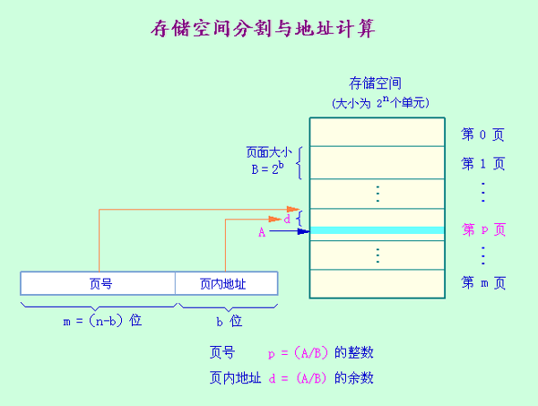
Cache基本知识
1．存储空间分割与地址计算
2．Cache和主存分块

Slide 12
存储层次的性能参数
假设：S ── 容量
T_{A} ── 访问时间
C ── 每位价格
下面仅考虑由 M₁ 和 M₂ 构成的两级存储层次：
M₁的参数：S₁，T_{A1}，C₁
M₂的参数：S₂，T_{A2}，C₂
C₁S₁＋C₂S₂
1. 每位价格C C＝ ─────
S₁＋S₂

Slide 13
存储层次的性能参数
2. 命中率 H 和失效率 F
H＝N₁/(N₁＋N₂)
N₁ ── 访问M₁的次数
N₂ ── 访问M₂的次数
失效率 F＝1－H
3. 平均访问时间 T_{A}
T_{A}＝T_{A1}＋(1－H )T_{M}
或 T_{A}＝T_{A1}＋F T_{M}
T_{A1} ── 命中时间
T_{M} ── 失效开销

Slide 14
Memory Hierarchy: Terminology 术语
Hit 命中: data appears in some block in the upper level (example: Block X)
  Hit Rate: the fraction of memory access found in the upper level
  Hit Time: Time to access the upper level which consists of
    RAM access time + Time to determine hit/miss
Miss 失效: data needs to be retrieve from a block in the lower level (Block Y)
  Miss Rate = 1 - (Hit Rate)
  Miss Penalty: Time to replace a block in the upper level +
    Time to deliver the block the processor
Hit Time << Miss Penalty
Lower Level
Memory
To Processor
Upper Level
Memory
Blk X
From Processor
Blk Y
Notes:
CS2007
A HIT is when the data the processor wants to access is found in the upper level (Blk X).
The fraction of the memory access that are HIT is defined as HIT rate.
HIT Time is the time to access the Upper Level where the data is found (X). It consists of:
(a) Time to access this level.
(b) AND the time to determine if this is a Hit or Miss.
If the data the processor wants cannot be found in the Upper level. Then we have a miss and we need to retrieve the data (Blk Y) from the lower level.
By definition (definition of Hit: Fraction), the miss rate is just 1 minus the hit rate.
This miss penalty also consists of two parts:
(a) The time it takes to replace a block (Blk Y to BlkX) in the upper level.
(b) And then the time it takes to deliver this new block to the processor.
It is very important that your Hit Time to be much much smaller than your miss penalty. Otherwise, there will be no reason to build a memory hierarchy.
+2 = 14 min. (X:54)

Slide 15
4 Questions for Memory Hierarchy
Q1: Where can a block be placed in the upper level? (块的放置：映像规则 Block placement)
Q2: How is a block found if it is in the upper level?
(块的定位：查找算法 Block identification)
Q3: Which block should be replaced on a miss?
(块的替换：替换算法 Block replacement)
Q4: What happens on a write?
(写策略 Write strategy)

Slide 16
Q1: Where can a block be placed in the upper level?
Block 12 placed in 8 block cache:
  Fully associative, direct mapped, 2-way set associative
  Set Asso. Mapping = Block Number Modulo取模 Number Sets
直接映像
Direct Mapped
(12 mod 8) = 4
2-路组相联
2-Way Assoc
(12 mod 4) = 0
全相联
Full Mapped
01234567
01234567
01234567
Cache
1111111111222222222233
01234567890123456789012345678901
Memory
Notes:
CS2007
真正的Cache包括几百块，主存包括成百万的块。

Slide 17
映象规则
1. 全相联映象：主存中的任一块可以被放置到 Cache中的任意一个位置。 举例
对比：阅览室位置 ── 随便坐
特点：空间利用率最高，冲突概率最低，实现最复杂。
2. 直接映象：主存中的每一块只能被放置到 Cache中唯一的一个位置。 举例
对比：阅览室位置 ── 只有一个位置可以坐
特点：空间利用率最低，冲突概率最高，实现最简单。
对于主存的第i 块，若它映象到Cache的第j 块，则:
j＝i mod (M ) （M为Cache的块数）
设M＝2^{m}，则当表示为二进制数时，j 实际上就是I 的低m 位：
i：
j
m位

Slide 18
映象规则
3. 组相联映象：主存中的每一块可以被放置到Cache中唯一的一个组中的任何一个位置。举例。
组相联是直接映象和全相联的一种折衷
组的选择常采用位选择算法
若主存第i 块映象到第k 组，则:
k＝i mod（G） （G为Cache的组数）
设G＝2^{g}，则当表示为二进制数时，k 实
际上就是i 的低 g 位：
i：
k
g 位

Slide 19
映象规则
◆ n 路组相联：每组中有n 个块(n＝M/G ) n 称为相联度。
相联度越高，Cache空间的利用率就越高，块冲突概率就越低，失效率也就越低。
n (路数)
G (组数)
全相联
M
1
直接映象
1
M
组相联
1＜n＜M
1＜G＜M
◆ 绝大多数计算机的Cache: n ≤4
想一想：相联度一定是越大越好？

Slide 20
Q2: How is a block found if it is in the upper level?
如何确定Cache中是否有所要访问的块？
答案：查找目录表！
目录表结构
只需查找候选位置所对应的目录表项
并行查找与顺序查找
提高性能的重要思想：主候选位置(MRU块，Most Recently Used)
Notes:
CS2007

Slide 21
Q2: How is a block found if it is in the upper level?
Tag on each block 地址标志
  No need to check index or block offset
Increasing associativity shrinks index, expands tag
Block Address
Block
Offset
Tag
Index
Block address = tag + index, Index是组地址，tag是块标记
e.g. Block address : 101101, tag = 10, index = 1101
index的位数表示分组数，tag的位数表示相联度。
The three portions of an address in a set-associative or direct-mapped cache.
  The tag is used to check all the blocks in the set, and the index is used to select the set. The block offset is the address of the desired data within the block.
  Fully associative caches have no index field.
Notes:
CS2007
16个分组，每组4块。Index的位数表示分组数，Tag的位数表示相联度。
Block address = tag + index, e.g. Block address : 101101, tag = 10, index = 1101 (16 blocks)

Slide 22
Direct-Mapped Cache
Block
Offset
直接映象Cache的查找过程演示
Tag
Index
t
k
b
V
Tag
Data Block
V=Valid
2^{k}
lines
t
=
HIT
Data Word or Byte
Notes:
CS2007
V=Valid

Slide 23
2-Way Set-Associative Cache
Tag
Index
Block
Offset
b
４路组相联Cache的查找过程演示
t
k
V
Tag
Data Block
V
Tag
Data Block
t
=
=
Data
Word
or Byte
HIT

Slide 24
Fully Associative Cache
V
Tag
Data Block
t
=
Tag
t
=
HIT
Block
Offset
Data
Word
or Byte
=
b

Slide 25
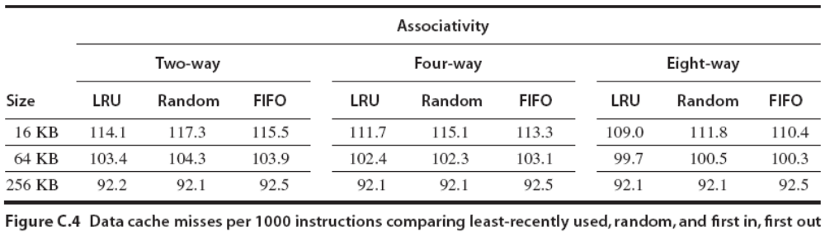
Q3: Which block should be replaced on a miss?
Easy for Direct Mapped, no choice
Set Associative or Fully Associative:
  Random
  LRU (Least Recently Used)
  First in, first out (FIFO)

Slide 26
Q4: What happens on a write?
写策略
1. “写”操作所占的比例
Load指令：26％
Store指令：9％
“写”在所有访存操作中所占的比例：
9％/(100％＋26％＋9％)≈7％
“写”在访问数据Cache操作中所占的比例：
9％/(26％＋9％)≈25％
2. “写”操作必须在确认是命中后才可进行
3．“写”访问有可能导致Cache和主存内容的不一致
Notes:
CS2007
100%=取指令

Slide 27
Q4: What happens on a write?
 | Write-Through 写直达 | Write-Back 写回
Policy | Data written to cache block also written to lower-level memory | Write data only to the cache Update lower level when a block falls out of the cache
Debug | Easy | Hard
Do read misses produce writes? | No | Yes
Do repeated writes make it to lower level? | Yes | No
Advantage | Easier to implement, simplify data coherency | Use less memory bandwidth
Additional option -- let writes to an un-cached address allocate a new cache line (“write-allocate”).
Notes:
CS2007
读缺失产生写：读缺失需要换页，被换掉的页可能会写回内存。

Slide 28
Write allocate and No-write allocate
Write allocate (fetch on write) 按写分配 (写时取)
  The block is allocated on a write miss, followed by the write hit actions above. In this natural option, write misses act like read misses.
  写失效时，先把所写单元所在的块调入Cache，再行写入。
  Write-back caches always use.
No-write allocate (write around) 不按写分配 (绕写法)
  This apparently unusual alternative is write misses do not affect the cache. Instead, the block is modified only in the lower-level memory.
  Write-through caches often use.

Slide 29
Write Policy Choices
Cache hit:
  write through: write both cache & memory
    generally higher traffic but simplifies cache coherence 一致性
  write back: write cache only
  (memory is written only when the entry is evicted 收回)
    a dirty bit “污染位” per block can further reduce the traffic
Cache miss:
  no write allocate: only write to main memory
  write allocate (aka fetch on write): fetch into cache
Common combinations:
  write through and no write allocate
  write back with write allocate
Notes:
CS2007

Slide 30
Write Buffers for Write-Through Caches
Cache
Lower Level Memory
Processor
Write Buffer
Holds data awaiting write-through to
lower level memory
Q. Why a write buffer 写缓存?
A. So CPU doesn’t stall 写停顿
Q. Why a buffer, why not just one register ?
A. Bursts 爆发 of writes are
common.
Q. Are Read After Write (RAW) hazards an issue for write buffer?
A. Yes! Drain buffer before next read, or send read 1st after check write buffers.

Slide 31
CPU-Cache Interaction 交互
(5-stage pipeline)
0x4
Add
E
Decode,
Register
Fetch
M
A
we
Y
addr
nop
ALU
Y
IR
B
Primary
Data
Cache
rdata
PC
addr
inst
D
R
wdata
hit?
hit?
wdata
  PCen
Primary
Instruction
Cache
MD1
MD2
Stall entire CPU on data cache miss
To Memory Control
Cache Refill Data from Lower Levels of Memory Hierarchy
What about Instruction miss or writes to i-stream ?
Notes:
CS2007
How are writes to istream handled?

Slide 32
Cache Measures
Hit rate: fraction found in that level
  So high that usually talk about Miss rate
  Miss rate fallacy 错误: as MIPS to CPU performance,
  miss rate to average memory access time in memory
Average memory-access time
= Hit time + Miss rate x Miss penalty
(ns or clocks)
Miss penalty: time to replace a block from lower level, including time to replace in CPU
  access time: time to lower level
  = f (Latency to lower level)
  transfer time: time to transfer block
  =f (BandWidth between upper & lower levels)

Slide 33
6 Basic Cache Optimizations
Reducing Miss Rate
Larger Block size (compulsory misses)
Larger Cache size (capacity misses)
Higher Associativity (conflict misses)
Reducing Miss Penalty
Multilevel Caches
Giving Reads Priority over Writes
  E.g., Read complete before earlier writes in write buffer
Reducing hit time
6. Avoiding address translation when indexing the cache

Slide 34
What causes a MISS?
Three Major Categories of Cache Misses:
Compulsory 强制性 —The very first access to a block cannot be in the cache, so the block must be brought into the cache. These are also called cold-start misses (冷启动失效) or first-reference misses.(首次访问失效)
Capacity 容量 —If the cache cannot contain all the blocks needed during execution of a program, capacity misses will occur because of blocks being discarded and later retrieved.
Conflict 冲突 —If the block placement strategy is set associative or direct mapped, conflict misses will occur because a block may be discarded and later retrieved if too many blocks map to its set. These misses are also called collision misses(碰撞失效).
Notes:
CS2007
The idea is that hits in a fully associative cache that become misses in an n-way set-associative cache are due to more than n requests on some popular sets.

Slide 35
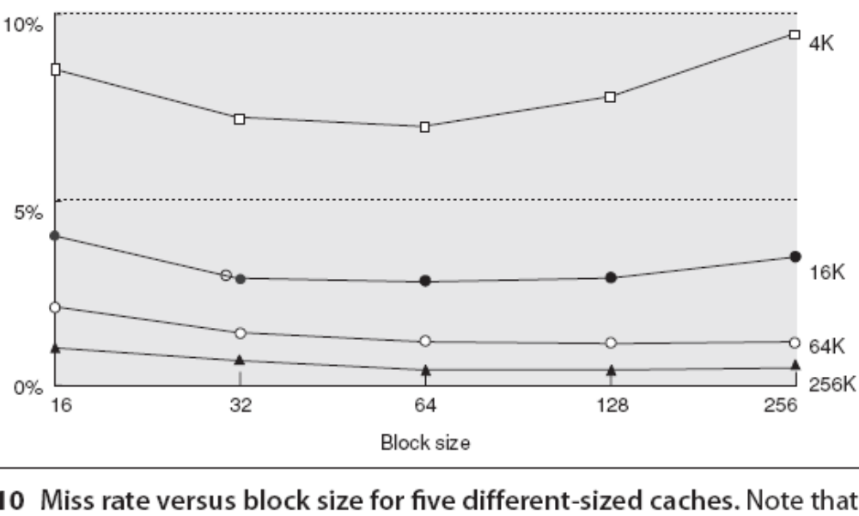
First Optimization: Larger Block Size to Reduce Miss Rate
Larger block sizes will reduce compulsory misses, because the principle of locality has two components: temporal locality and spatial locality. Larger blocks take advantage of spatial locality.

Slide 36
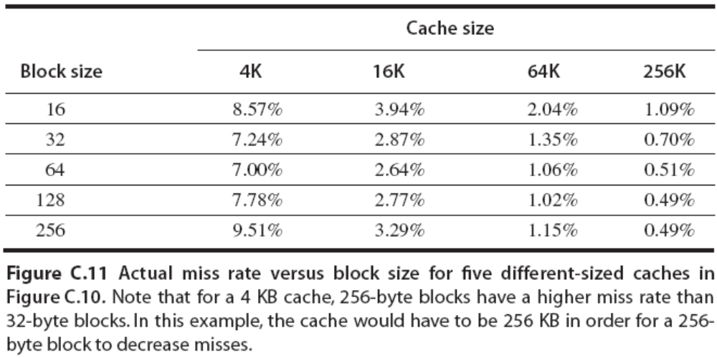
Larger Blocks may Increase Conflict Misses
Since they reduce the number of blocks in the cache, larger blocks may increase conflict misses and even capacity misses if the cache is small.

Slide 37
Larger Blocks may Increase the Miss Penalty
Example Assume the memory system takes 80 clock cycles of overhead(系统开销) and then delivers 16 bytes every 2 clock cycles. Thus, it can supply 16 bytes in 82 clock cycles, 32 bytes in 84 clock cycles, and so on. Which block size has the smallest average memory access time for each cache size?
Assume the hit time is 1 clock cycle
Answer Average memory access time = Hit time + Miss rate（查上页表） × Miss penalty
Average memory access time for a 16-byte block in a 4 KB cache is 1 + (8.57% × 82) = 8.027 cycles
for a 256-byte block in a 256 KB cache the is
1 + [0.49% × (80 + 32) ] = 1.549 clock cycles

Slide 38
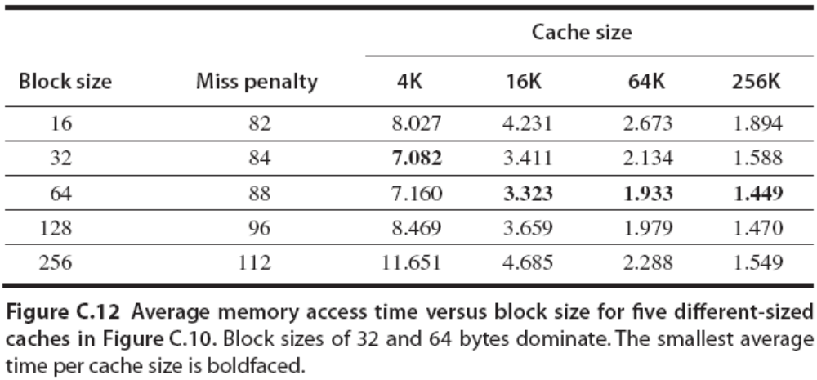
Cache Designer: Minimize Both the Miss Rate and the Miss Penalty
The selection of block size depends on both the latency and bandwidth of the lower-level memory.

Slide 39
Second Optimization: Larger Caches to Reduce Miss Rate
The obvious way to reduce capacity misses is to increase capacity of the cache.
The obvious drawback(缺点) is potentially longer hit time and higher cost and power.
This technique has been especially popular in off-chip caches.

Slide 40
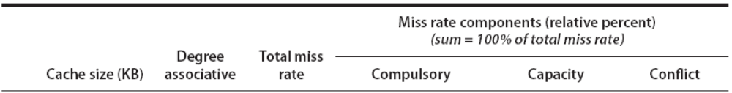
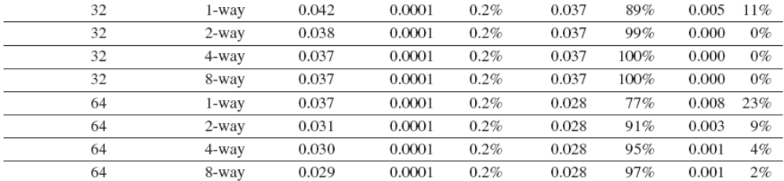
Third Optimization: Higher Associativity to Reduce Miss Rate
Figure shows how miss rates improve with higher associativity (相联度).
Increasing block size reduces miss rate while increasing miss penalty, and greater associativity can come at the cost of increased hit time.
Notes:
CS2007
Like many of these examples, improving one aspect of the average memory access time comes at the expense of another.

Slide 41
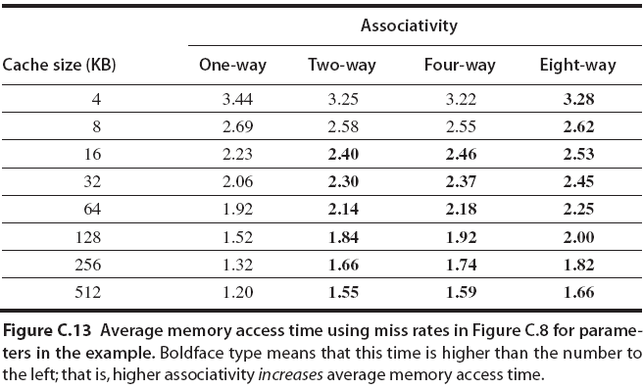
Higher Associativity Increase the Clock Cycle Time
Clock cycle time2-way = 1.36 × Clock cycle time1-way
Clock cycle time4-way = 1.44 × Clock cycle time1-way
Clock cycle time8-way = 1.52 × Clock cycle time1-way
Notes:
CS2007
Assume that the hit time is 1 clock cycle, that the miss penalty for the directmapped case is 25 clock cycles to a level 2 cache (see next subsection) that never misses, and that the miss penalty need not be rounded to an integral number of clock cycles.
命中时间增加了，主要是用于查找命中块。

Slide 42
Fourth Optimization: Multilevel Caches to Reduce Miss Penalty
The performance gap between processors and memory leads the architect to this question: Should I make the cache faster to keep pace with the speed of processors, or make the cache larger to overcome the widening gap between the processor and main memory?
One answer is, do both. Adding another level of cache between the original cache and memory simplifies the decision.
The first-level cache can be small enough to match the clock cycle time of the fast processor. Yet the second-level cache can be large enough to capture many accesses that would go to main memory, thereby lessening the effective miss penalty.
Notes:
CS2007

Slide 43
A Typical Memory Hierarchy
Split instruction & data primary caches
(on-chip SRAM)
Multiple interleaved memory banks
(off-chip DRAM)
L1 Instruction Cache
Unified L2 Cache
Memory
CPU
Memory
L1 Data Cache
Memory
RF
Memory
Multiported register file (part of CPU)
Large unified secondary cache (on-chip SRAM)
Implementation close to the CPU looks like a Harvard machine
Notes:
CS2007
哈佛结构处理器有两个明显的特点：
使用两个独立的存储器模块，分别存储指令和数据，每个存储模块都不允许指令和数据并存；
使用独立的两条总线，分别作为CPU与每个存储器之间的专用通信路径，而这两条总线之间毫无关联

Slide 44
It Complicates Performance Analysis
the original formula is Average memory access time
= Hit time_{L1} + Miss rate_{L1} × Miss penalty_{L1}
And Miss penalty_{L1}
= Hit time_{L2} + Miss rate_{L2} × Miss penalty_{L2}
So Average memory access time
= Hit time_{L1} + Miss rate_{L1} × (Hit time_{L2} + Miss rate_{L2} × Miss penalty_{L2})
To avoid ambiguity(不确定性), these terms are adopted here for a two-level cache system:
Local miss Such as Miss rate_{L1}, and Miss rate_{L2}.
Global miss The global miss rate for the first-level cache is still just Miss rate_{L1}, but for the second-level cache it is Miss rate_{L1} × Miss rate_{L2}.

Slide 45
Fifth Optimization: Giving Priority to Read Misses over Writes to Reduce Miss Penalty
With a write-through cache the most important improvement is a write buffer of the proper size.
Write buffers do complicate memory accesses because they might hold the updated value of a location needed on a read miss.
Assume a direct-mapped, write-through cache that maps 512 and 1024 to the same block, and a four-word write buffer that is not checked on a read miss. Will the value in R2 always be equal to the value in R3?
  SW R3, 512(R0) ;M[512] ← R3 (cache index 0)
  LW R1, 1024(R0) ;R1 ← M[1024] (cache index 0)
  LW R2, 512(R0) ;R2 ← M[512] (cache index 0)

Slide 46
Solve the Problem
The simplest way out of this dilemma is for the read miss to wait until the write buffer is empty.
The alternative is to check the contents of the write buffer on a read miss, and if there are no conflicts and the memory system is available, let the read miss continue.
The cost of writes by the processor in a write-back cache can also be reduced. Suppose a read miss will replace a dirty memory block. Instead of writing the dirty block to memory, and then reading memory, we could copy the dirty block to a buffer, then read memory, and then write memory. This way the processor read, for which the processor is probably waiting, will finish sooner.
Notes:
CS2007
Dilemma n.进退两难的局面, 困难的选择

Slide 47
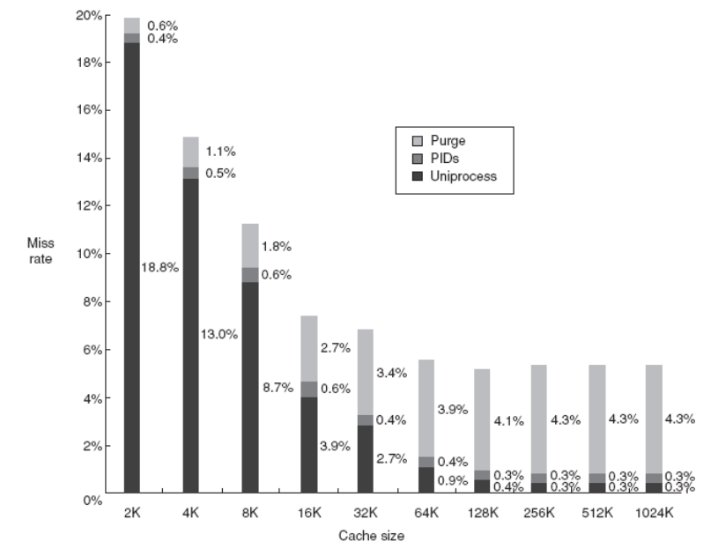
Sixth Optimization: Avoiding Address Translation during Indexing of the Cache to Reduce Hit Time
Cache must cope with the translation of a virtual address from the processor to a physical address to access memory.
virtual caches vs. physical cache
  Using virtual addresses for the cache eliminates address translation time from a cache hit.
  When a process is switched, the virtual addresses refer to different physical addresses, requiring the cache to be flushed. One solution is to increase the width of the cache address tag with a process-identifier tag (PID).
Notes:
CS2007
虚拟Cache没有流行起来的一个原因是操作系统和用户程序对于同一个物理地址可能采用两种以上不同形式的虚拟地址来访问，这些地址称为同义或别名。它们可能会导致同一个数据在虚拟Cache中存在两个副本。如果其中一个被修改，那么再使用另一个的数据就是错误的。这种情况在物理Cache中是不会发生的，因为这些访问首先会把虚拟地址转换到同一物理地址，从而找到同一个物理Cache块。

Slide 48
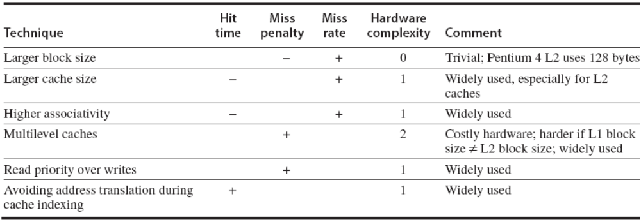
Summary of Basic Cache Optimization
Figure below summarizes these techniques and estimates the impact on complexity, with + meaning that the technique improves the factor, – meaning it hurts that factor, and blank meaning it has no impact.
No optimization in this figure helps more than one category.
Notes:
CS2007
The techniques in this section to improve miss rate, miss penalty, and hit time generally impact the other components of the average memory access equation as well as the complexity of the memory hierarchy.

Slide 49
11 Advanced Cache Optimizations
Reducing hit time
Small and simple caches
Way prediction
Trace caches
Increasing cache bandwidth
Pipelined caches
Multibanked caches
Nonblocking caches
Reducing Miss Penalty
Critical word first
Merging write buffers
Reducing Miss Rate
Compiler optimizations
Reducing miss penalty or miss rate via parallelism
Hardware prefetching
Compiler prefetching
Notes:
CS2007

Slide 50
降低Cache失效率：Victim Cache
基本思想：
在Cache和它从下一级存储器调数据的通路之间设置一个全相联的小Cache，用于存放被替换出去的块(称为Victim)，以备重用
作用：
对于减小冲突失效很有效，特别是对于小容量的直接映象数据Cache，作用尤其明显。例如，项数为4的Victim Cache:使4KB Cache的冲突失效减少20%～90%
工作过程

Slide 51
降低Cache失效率：伪相联Cache
取直接映象及组相联两者的优点：
命中时间小，失效率低
基本思想及工作原理 (动画演示)
在逻辑上把直接映象Cache的空间上下平分为两个区。对于任何一次访问，伪相联Cache先按直接映象Cache的方式去处理。若命中，则其访问过程与直接映象Cache的情况一样。若不命中，则再到另一区相应的位置去查找。若找到，则发生了伪命中，否则就只好访问下一级存储器。
快速命中与慢速命中
要保证绝大多数命中都是快速命中。

Slide 52
Outline
Memory hierarchy
Locality
Cache design
Virtual address spaces
Page table layout
Virtual memory summary
TLB design options
Conclusion

Slide 53
The Limits of Physical Addressing
“Physical addresses” of memory locations
A0-A31
A0-A31
CPU
Memory
D0-D31
D0-D31
Data
All programs share one address space:
The physical address space
Machine language programs must be
aware of the machine organization
No way to prevent a program from accessing any machine resource

Slide 54
Solution: Add a Layer of Indirection
“Virtual Addresses”
“Physical Addresses”
A0-A31
Virtual
Physical
A0-A31
CPU
Address
Translation
Memory
D0-D31
D0-D31
Data
User programs run in an standardized
virtual address space
Address Translation hardware
managed by the operating system (OS)
maps virtual address to physical memory
Hardware supports “modern” OS features:
Protection, Translation, Sharing

Slide 55
Three Advantages of Virtual Memory
Translation:
  Program can be given consistent(一致的) view of memory, even though physical memory is scrambled (混乱的)
  Makes multithreading reasonable (now used a lot!)
  Only the most important part of program (“Working Set”) must be in physical memory.
  Contiguous(连续的) structures (like stacks) use only as much physical memory as necessary yet still grow later.
Protection:
  Different threads (or processes) protected from each other.
  Different pages can be given special behavior
    (Read Only, Invisible to user programs, etc).
  Kernel data protected from User programs
  Very important for protection from malicious(怀恶意的)programs
Sharing:
  Can map same physical page to multiple users
  (“Shared memory”)
Notes:
CS2007
每个用户有一个页表
每一个用户页在页表中有一行
操作系统确保不同的页表不交叠

Slide 56
Four Memory Hierarchy Questions Revisited
Q1: Where Can a Block Be Placed in Main Memory?
  Operating systems allow blocks to be placed anywhere in main memory. The strategy is fully associative.
Q2: How Is a Block Found If It Is in Main Memory?
  Both paging and segmentation rely on a data structure that is indexed by the page or segment number. For paging, this data structure is page table which contains the physical page address. Indexed by the virtual page number, the size of the table is the number of pages in the virtual address space.
  Given a 32-bit virtual address,4 KB pages, and 4 bytes per Page Table Entry (PTE), the size of the page table would be (2³²/2¹²) × 2² = 2²² or 4 MB.
Notes:
CS2007
32位虚地址空间，每页4KB，页表每项4字节(32bit)

Slide 57
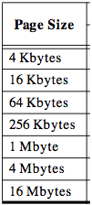
A virtual address space is divided into Pages
Virtual
Address Space
Physical
Address Space
A virtual address space
is divided into blocks
of memory called pages
page
page
page
page
A machine usually supports
pages of a few sizes
(MIPS R4000):

Slide 58
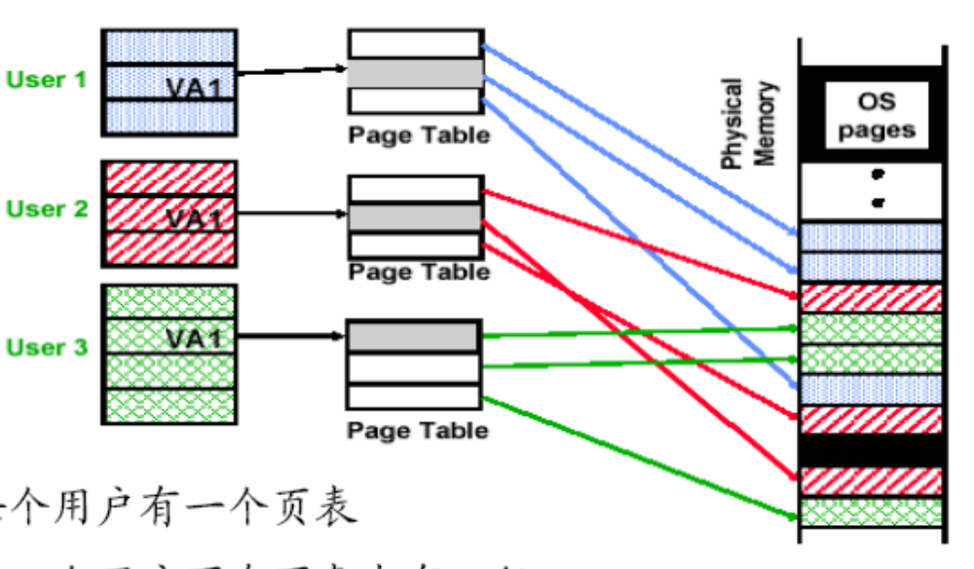
Page tables encode virtual address spaces
Page Table
Physical
Memory Space
frame
frame
frame
frame
virtual address
OS manages the page table for each ASID
(address-space identifier)
A page table is indexed by a
virtual address
A valid page table entry codes physical memory “frame” address for the page
Notes:
CS2007
the address space identifier (ASID) is like a process ID (PID).

Slide 59
Details of Page Table
Page Table
Physical
Memory Space
Virtual Address
frame
12
frame
V page no.
offset
frame
frame
Page Table
Page Table
Base Reg
V
Access
Rights
PA
index
into
page
table
virtual address
table located
in physical
memory
P page no.
offset
12
Physical Address
Page table maps virtual page numbers to physical frames (“PTE” = Page Table Entry)

Slide 60
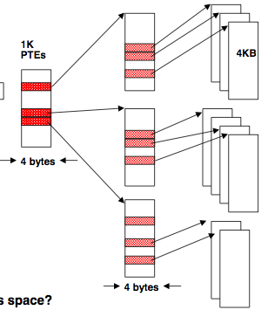
Page tables may not fit in memory!
A table for 4KB pages for a 32-bit address space has 1M entries, 4 MB Size
Each process needs its own address space!
Two-level Page Tables
32 bit virtual address
31
22
21
12
11
0
P1 index
P2 index
Page Offset
Top-level table wired in main memory
Subset of 1024 second-level tables in main memory; rest are on disk or unallocated

Slide 61
Four Memory Hierarchy Questions Revisited(cont.)
Q3: Which Block Should Be Replaced on a Virtual Memory Miss?
  Replace the least-recently used (LRU) page.
  A use bit or reference bit is provided. The operating system periodically clears the bits and later records them so it can determine which pages were touched during a particular time period.
Q4: What Happens on a Write?
  Because of the great discrepancy(差异) in access time, the write strategy is always write back.
  Virtual memory systems usually include a dirty bit. It allows blocks to be written to disk only if they have been altered since being read from the disk.

Slide 62
VM and Disk: Page replacement policy
Page Table
Dirty bit: page written.
Used bit: set to
1 on any reference
dirty
used
1 0
...
1 0
0 1
1 1
0 0
Set of all pages
in Memory
Tail pointer:
Clear the used
bit in the
page table
Head pointer
Place pages on free list if used bit
is still clear.
Schedule pages with dirty bit set to
be written to disk.
Freelist
Architect’s role: support setting dirty and used bits
Free Pages

Slide 63
Caching vs. Demand Paging
secondary
memory
CPU
primary
memory
CPU
primary
memory
cache
Caching Demand paging
  cache entry page frame
  cache block (~32 bytes) page (~4K bytes)
  cache miss rate (1% to 20%) page miss rate (<0.001%)
  cache hit (~1 cycle) page hit (~100 cycles)
  cache miss (~100 cycles) page miss (~5M cycles)
  a miss is handled a miss is handled
  in hardware mostly in software
Notes:
CS2007
Demand paging 请求分页（按需分页）

Slide 64
Further Differences Between Caches and Virtual Memory
Replacement on cache misses is primarily controlled by hardware, while virtual memory replacement is primarily controlled by the operating system.
The size of the processor address determines the size of virtual memory, but the cache size is independent of the processor address size.
In addition to acting as the lower-level backing store for main memory in the hierarchy, secondary storage is also used for the file system. In fact, the file system occupies most of secondary storage.
Notes:
CS2007
The longer miss penalty means it’s more important to make a good decision, so the operating system can be involved and take time deciding what to replace

Slide 65
TLB Design Concepts
Translation Look-Aside Buffer (TLB)
地址变换后备缓存
To reduce address translation time, computers use a cache dedicated to these address translations.

Slide 66
Techniques for Fast Address Translation
Page table is kept in main memory (kernel memory)
  Each process has a page table
Every data/instruction access requires two memory accesses
  One for the page table and one for the data/instruction
  Can be solved by the use of a special fast-lookup hardware cache called associative registers or translation look-aside buffers (TLBs). If locality applies then cache the recent translation
TLB entry: virtual page no, physical page no, protection bit, use bit, dirty bit

Slide 67
MIPS Address Translation: How does it work?
“Virtual Addresses”
“Physical Addresses”
A0-A31
Virtual
Physical
A0-A31
Translation
Look-Aside
Buffer
(TLB)
CPU
Memory
D0-D31
D0-D31
Data
Translation Look-Aside Buffer (TLB)
A small fully-associative cache of
mappings from virtual to physical addresses
TLB also contains
protection bits for virtual address
Fast common case: Virtual address is in TLB,
process has permission to read/write it.

Slide 68
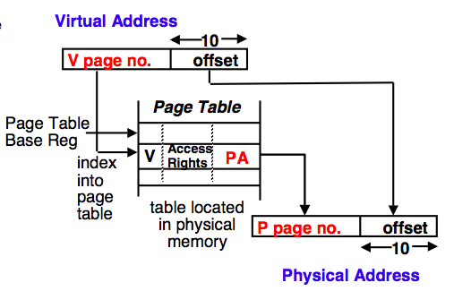
The TLB caches page table entries
Physical and virtual pages must be the same size!
TLB caches page table entries.
Physical
frame
address
virtual address
for ASID
page
off
Page Table
2
0
1
3
V=0 pages either reside on disk or have not yet been allocated.
OS handles V=0
“Page fault”
physical address
TLB
page
off
frame
page
MIPS handles TLB misses in software (random replacement). Other machines use hardware.
2
2
0
5

Slide 69
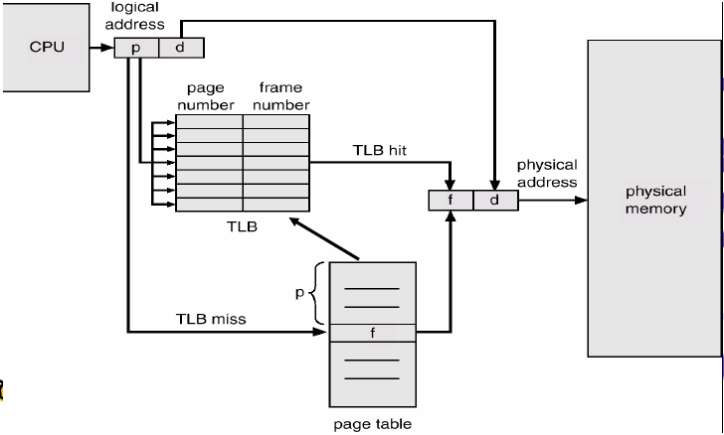
Paging Hardware with TLB

Slide 70
Use virtual addresses for cache?
“Virtual Addresses”
“Physical Addresses”
A0-A31
Virtual
Physical
A0-A31
Virtual
Translation
Look-Aside
Buffer
(TLB)
CPU
Cache
Main Memory
D0-D31
D0-D31
D0-D31
Only use TLB on a cache miss !
Downside: a subtle, fatal problem. What is it?
A. Synonym(同义字) problem. If two address spaces share a physical frame, data may be in cache twice. Maintaining consistency is a nightmare.

Slide 71
虚拟存储器进程保护和地址转换实例
TLB地址转换：
Alpha Axp 21064 的TLB地址转换过程
进程保护：
Alpha的地址空间分为3段
kseg(地址最高两位：10) (内核)
seg0(最高位： 0) (用户)
seg1(最高两位： 11) (用户)
页表地址变换：
Alpha三级页表地址变换过程
Alpha的页表项(PTE)

Slide 72
Summary #1/3: Caches
The Principle of Locality:
  Program access a relatively small portion of the address space at any instant of time.
    Temporal Locality: Locality in Time
    Spatial Locality: Locality in Space
Three Major Categories of Cache Misses:
  Compulsory Misses: sad facts of life. Example: cold start misses.
  Capacity Misses: increase cache size
  Conflict Misses: increase cache size and/or associativity.
  Nightmare Scenario: ping pong effect!
Write Policy: Write Through vs. Write Back
Today CPU time is a function of (ops, cache misses) vs. just f(ops): affects Compilers, Data structures, and Algorithms
Notes:
CS2007

Slide 73

Summary #2/3:
The Cache Design Space
Several interacting dimensions
  cache size
  block size
  associativity
  replacement policy
  write-through vs write-back
  write allocation
The optimal choice is a compromise(折衷)
  depends on access characteristics
    workload
    use (I-cache, D-cache, TLB)
  depends on technology / cost
Simplicity often wins
Cache Size
Associativity
Block Size
Bad
Good
Factor A
Factor B
Less
More
Notes:
CS2007
No fancy replacement policy is needed for the direct mapped cache.
As a matter of fact, that is what cause direct mapped trouble to begin with: only one place to go in the cache--causes conflict misses.
No fancy replacement policy is needed for the direct mapped cache.
As a matter of fact, that is what cause direct mapped trouble to begin with: only one place to go in the cache--causes conflict misses.
Besides working at Sun, I also teach people how to fly whenever I have time.
Statistic have shown that if a pilot crashed after an engine failure, he or she is more likely to get killed in a multi-engine light airplane than a single engine airplane.
The joke among us flight instructors is that: sure, when the engine quit in a single engine stops, you have one option: sooner or later, you land. Probably sooner.
But in a multi-engine airplane with one engine stops, you have a lot of options. It is the need to make a decision that kills those people.

Slide 74
Summary #3/3: TLB, Virtual Memory
Page tables map virtual address to physical address
TLBs are important for fast translation
TLB misses are significant in processor performance
  funny times, as most systems can’t access all of 2nd level cache without TLB misses!
Caches, TLBs, Virtual Memory all understood by examining how they deal with 4 questions:
1) Where can block be placed?
2) How is block found?
3) What block is replaced on miss?
4) How are writes handled?
Today VM allows many processes to share single memory without having to swap all processes to disk; today VM protection is more important than memory hierarchy benefits, but computers insecure
Notes:
CS2007
Let’s do a short review of what you learned last time.
Virtual memory was originally invented as another level of memory hierarchy such that programers, faced with main memory much smaller than their programs, do not have to manage the loading and unloading portions of their program in and out of memory.
It was a controversial proposal at that time because very few programers believed software can manage the limited amount of memory resource as well as human.
This all changed as DRAM size grows exponentially in the last few decades.
Nowadays, the main function of virtual memory is to allow multiple processes to share the same main memory so we don’t have to swap all the non-active processes to disk.
Consequently, the most important function of virtual memory these days is to provide memory protection.
The most common technique, but we like to emphasis not the only technique, to translate virtual memory address to physical memory address is to use a page table.
TLB, or translation lookaside buffer, is one of the most popular hardware techniques to reduce address translation time.
Since TLB is so effective in reducing the address translation time, what this means is that TLB misses will have a significant negative impact on processor performance.
+3 = 3 min. (X:43)

Slide 75
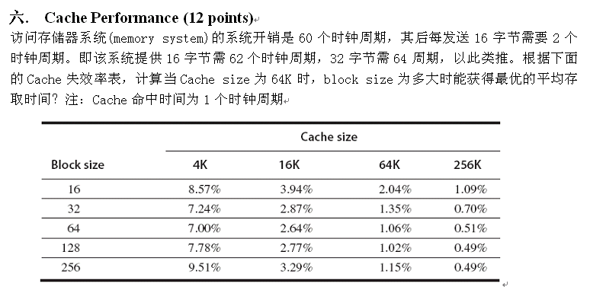
练习题

